Slide 1
Cyber Attack on the Ukrainian Power Grid AND YARA TOOL

Slide 2
Summary of Incidents
December 24, 2015: TSN reports "Half of Ivano-Frankivsk Region De-Energized" due to hacker attack.
Various media outlets including Washington Post, New York Times, BBC, etc., followed up on the report.U.S.
Department of Homeland Security (DHS) issued report IR-ALERT-H-16-056-01 on February 25, 2016.
Coordinated cyber attacks on three Ukrainian oblenergos within 30 minutes.
Attack impacted 225,000 customers, leading to manual operations.
Service restored quickly after several hours of outage window.
Impacted oblenergos continue to operate in operationally constrained mode.

Slide 3
Attacker Tactics Techniques and Procedures
Background:
In December 2015, Ukraine experienced a significant cyber attack on its power grid.
The attack targeted three electricity companies, resulting in widespread power outages.
Attack Overview:
Highly structured and well-resourced cyber actor executed the attack.
Utilized various tactics, including spear phishing, BlackEnergy 3 malware, and manipulation of Microsoft Office documents.
Attacker gained access to IT networks, harvested credentials, and infiltrated Industrial Control Systems (ICS).
Demonstrated expertise in operating ICS infrastructure, including Human Machine Interface (HMI) and field devices.
Impact:
Disruption of power supply to hundreds of thousands of people.
Irreparable damage to field devices, including serial-to-ethernet converters.
Denial-of-service attack on the energy company's call center.

Slide 4
Mitigation and Lessons Learned
Mitigation Strategies:
Implement two-factor authentication on VPNs to prevent unauthorized access.
Strengthen firewall configurations to restrict remote admin capabilities.
Deploy continuous monitoring of ICS networks for threat detection and anomaly detection.
Enhance employee training and awareness to mitigate spear phishing attacks.
Lessons Learned:
Importance of understanding attacker tactics and techniques for effective defense.
Need for proactive measures, such as continuous monitoring and threat intelligence sharing.
Critical role of response and recovery plans in mitigating the impact of cyber attacks on critical infrastructure.
Emphasis on collaboration between government, industry, and cybersecurity experts to enhance resilience against future attacks.

Slide 5
YARA TOOL
Open-source: YARA is an open-source tool, freely available for anyone to use and modify. This makes it accessible to a wide range of users, from individual researchers to large organizations.
Rule-based: YARA operates on a rule-based system, allowing users to create custom rulesets to detect specific patterns or characteristics in files, processes, or network traffic.
Pattern matching: Users can define patterns using strings, byte sequences, or regular expressions to match against data. This enables the detection of known malware signatures, behaviors, or indicators of compromise (IOCs).
Flexible syntax: YARA's syntax is flexible and powerful, supporting logical operators, wildcards, meta information, and more. This allows for the creation of complex rules to accurately identify malware.
Scalable: YARA is highly scalable and efficient, capable of processing large volumes of data quickly. It can handle thousands of rules and analyze millions of samples without significant performance impact.

Slide 6
Integration: YARA can be integrated into existing security workflows and tools, such as intrusion detection systems (IDS), antivirus solutions, security information and event management (SIEM) systems, and sandbox environments.
Community support: YARA benefits from an active user community that contributes to the development of rulesets and provides support through forums, online resources, and collaborative projects.
Threat intelligence: YARA can be used to search for indicators of compromise (IOCs) within files, memory, or network traffic, aiding in threat hunting, intelligence gathering, and incident response activities.
Forensic analysis: YARA rulesets are valuable tools for forensic analysts investigating security incidents. They can help identify and classify malware artifacts, understand attack techniques, and assess the extent of compromise.
Customization: YARA allows users to create and customize rulesets tailored to their specific needs or the characteristics of the malware they are targeting. This enables organizations to adapt their detection capabilities to evolving threats.

Slide 7
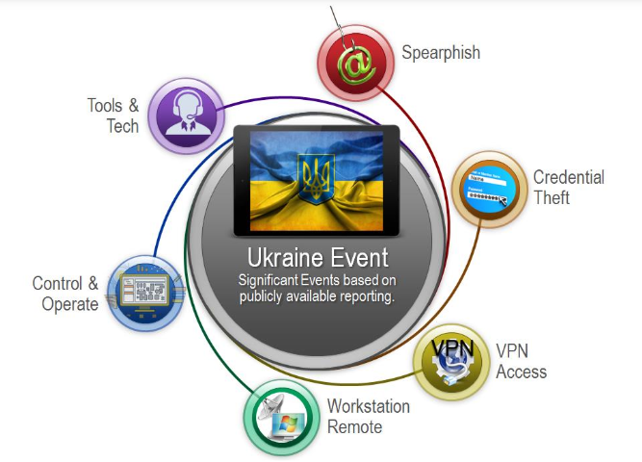
Ukraine Attack Consolidated Technical Components

Slide 8
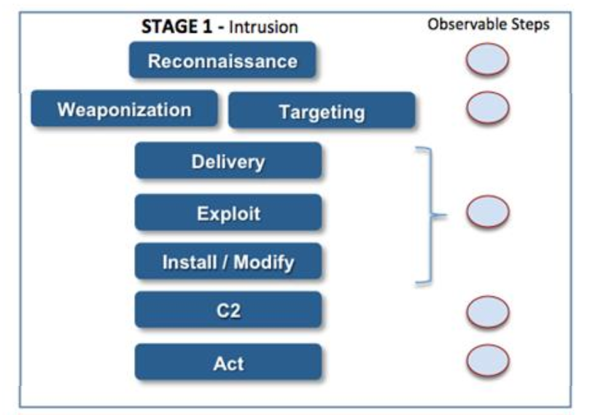
ICS Cyber Kill Chain Mapping

Slide 9
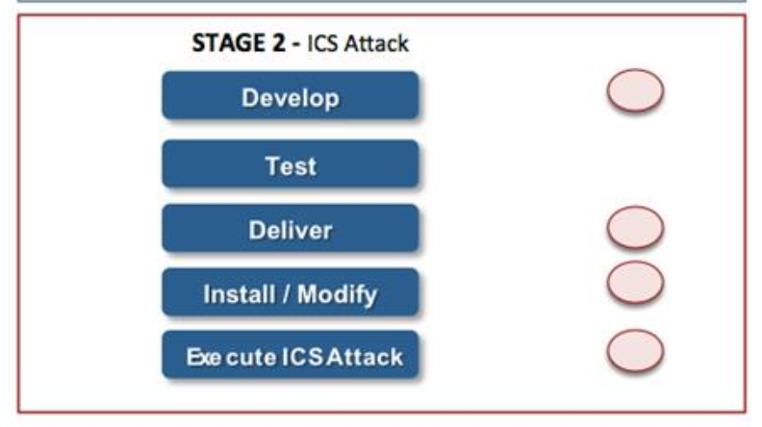

Slide 10
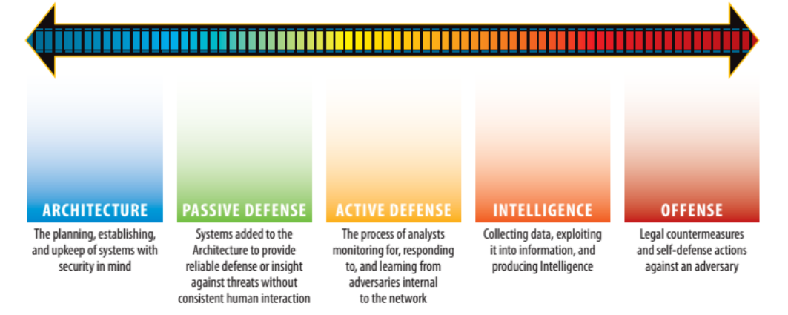
Defense Lessons Learned – Passive and Active Defenses
Sliding Scale of Cyber Security

Slide 11
Spear Phishing
Ukraine Attack
Adversary delivered targeted emails with malicious attachments to specific individuals.
Initial mitigation: End-user awareness training and ongoing phishing testing.
Application whitelisting recommended for preventing malware, but limited role in ICS environments.
Remote rogue client and OS-level remote admin features used in the attack.
The Next Attack
Adversary may pursue alternative social engineering campaigns (e.g., large-scale phishing, water-holing, direct-call campaigns).
Potential use of technical exploits not requiring social engineering.
Opportunities to Disrupt
Adversary likely to modify attacks in response to increased defenses.
Develop anticipatory responses to attack effects.
Treat email and internet-accessible assets as untrusted, segmented, monitored, and controlled.
Implement sandboxing technology to evaluate incoming documents and emails.
Use proxy systems to control communication paths and limit workstation access through proxy devices.

Slide 12
Credential Theft
Ukraine Attack
Adversary used BlackEnergy 3 to establish foothold and keystroke loggers for credential theft.
Initial mitigation: Obtain YARA rules for latest IOCs to search for BlackEnergy 3 infections.
Use antimalware removal tools to eliminate malware and change user passwords.
The Next Attack
Adversaries may use different remote access Trojans or updated versions of BlackEnergy 3.
Focus on directory segmentation (e.g., Active Directory, Domain) to detect and prevent attacker movement.
Opportunities to Disrupt
Monitor user account behavior, network and system communication, and directory-level activity.
Implement alarms with different priority levels based on system risk.
Note: YARA is a forensics tool, not a continuous monitoring solution

Slide 13
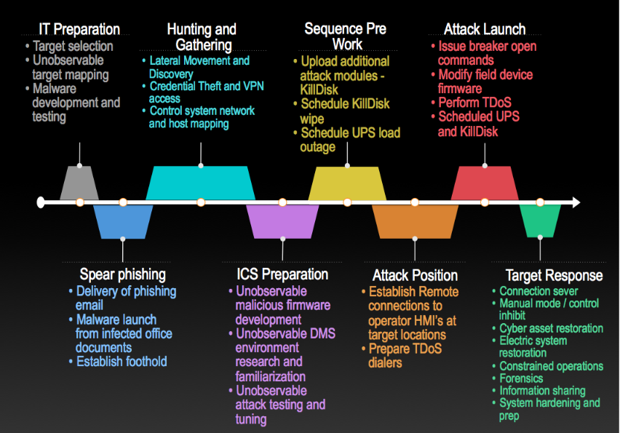
opportunities to disrupt the attack

Slide 14
Conclusion
The Ukrainian power grid attack underscores the need for proactive defense strategies and collaboration:
Defenders should focus on understanding attack sequences, disrupting coordinated attacks, and diversifying defense capabilities.
Avoid tunnel vision on specific malware and prioritize broader defense measures.
Enhance information sharing mechanisms for early attack detection and response.
Acknowledge the impressive response of Ukrainian oblenergos and government members.

Slide 15
Thank you Matsa Bhargav ra2111030010153

